Slide 1
Twitter Sentiment Analysis
Clustering
Ishraq Al Dagamseh
Nadia Badawi
Yousef Alomari

Slide 2

Sentiment analysis
In artificial intelligence (AI) techniques used to mine, extract and categorize users' opinions on a company, product, person, service, event, or idea for various
Sentiment analysis tools are essential to detect and understand customer feelings.
Companies that use these tools to understand how customers feel can use it to improve CX.
Collecting Users Data

Slide 3

Our DataSet
The dataset where consist of : (1023999, 6) No. of rows = 1023999 No. of columns = 6
Tweets extracted using the twitter API, tweets have been annotated (0 = negative, 1 = positive)
It contains the following 6 fields:
target: the polarity of the tweet (0 = negative, 1 = positive) ids: The id of the tweet (2087)
date: the date of the tweet flag: If there is no query, then this value is NO_QUERY.
user: the user that tweeted (robotickilldozr) text: the text of the tweet (Lyx is cool)
Files
train1.csv - the training set
test1.csv - the test set
sample.csv - a sample submission file in the correct format

Slide 4
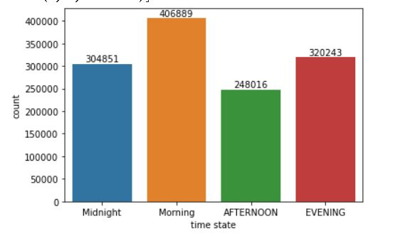
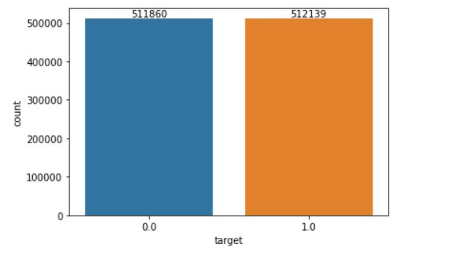
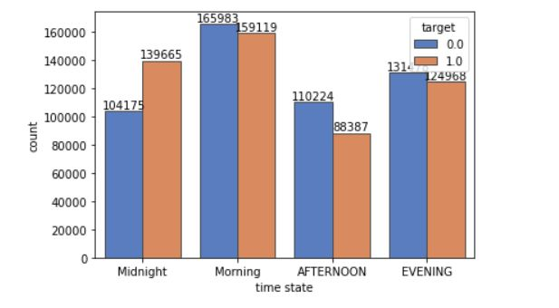
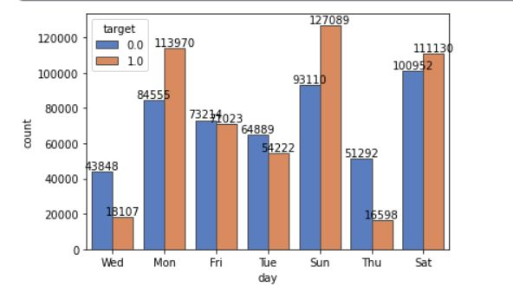
Data Visualizing

Slide 5





Solving Steps
Tweets as a set of user data
Turning or data to numbers
Entering the generated featured to the model
Trying to Manipulate the parameters to get the best result
Extracting features from the tweets text
By vectorising the text to numbers to enter it to the model

Slide 6

What we have used
Editing the text
Vectorization
01
04
Converting to lower case, removing the non alphabetical characters
TFIDF
Word2Vector with keras tokization
Using the Tokenize
02
05
Count vectorize
Entering the features to the model
Turning the text into words , removing the stop words
Visualizing the target data
K-Mean model
Minibatch Kmean
Trying to get an idea about the relationship between the columns
03
05
Results
Not that good using clustering

Slide 7
Compelling Headline
Some details about text preprocessing
Stemming
WordNetLemmatizer
It may be defined as the process to remove the inflectional forms of a word and bring them to a base form. #The two most common algorithms/methods employed for stemming include the: #Porter Stemmer #Snowball Stemmer We will be using Porter Stemmer in our process.
We will be using WordNet Lemmatizer in our process

Slide 8
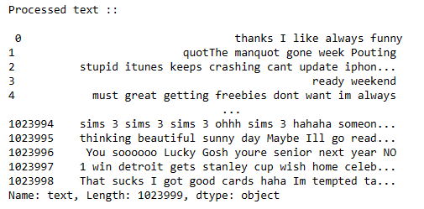
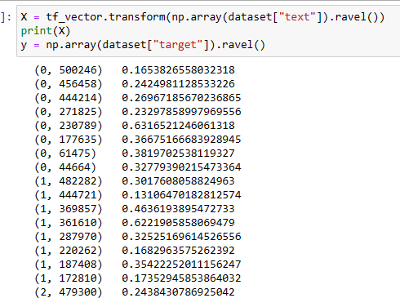
How the Text was Vs How it became

Slide 9



Modeling
K-means | Mini Batch K-means
K-means is an unsupervised learning method for clustering data points. The algorithm iteratively divides data points into K clusters by minimizing the variance in each cluster. | clustering algorithm is a version of the standard K-means algorithm in machine learning. It uses small, random, fixed-size batches of data to store in memory, and then with each iteration, a random sample of the data is collected and used to update the clusters.
TF_IDF
term frequency-inverse document frequency
43308 features
Count Vectorization
TF_IDF
255999 features
Word2vec
293999 features
* MiniBatchKMeans is faster but gives slightly different results

Slide 10
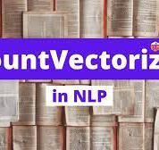
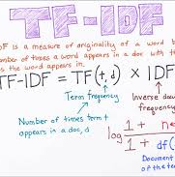
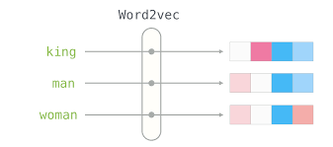
Results
K-mean
Mini-Batch
K-mean
Mini-Batch
K-mean
Mini-Batch
Local
0.51
0.52
0.53
0.50
0.50
0.50
private
0.513
0.501
0.5147
0.5145
0.508
0.498

Slide 11
Best Results
TF-IDF vectorization with K-means 0.51837

Slide 12
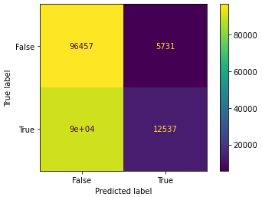
Confusion Matrix (TFIDF) with K-means
F
T

Slide 13
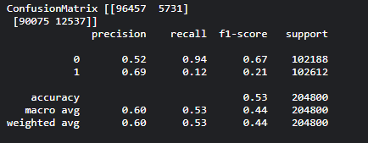
Classification Report (Best Results)

Slide 14
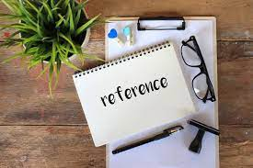
References
2. https://scikit-learn.org/stable/modules/generated/sklearn.cluster.KMeans.html
4. Paper: Mikolov, T., Chen, K., Corrado, G., & Dean, J. (2013). Efficient estimation of word representations in vector space. arXiv preprint arXiv:1301.3781.
5. https://dylancastillo.co/nlp-snippets-cluster-documents-using-word2vec/
6. Twitter Sentiment Analysis Twitter Sentiment Analysis by Tahaluf Al Emarat
1. https://en.wikipedia.org/wiki/Tf%E2%80%93idf
3. https://scikit-learn.org/stable/modules/generated/sklearn.cluster.MiniBatchKMeans.html

Slide 15



Thank you
Nadia
Yousef
Ishraq

